Slide 1


MYSQL

Slide 2
Kiểu dữ liệu SqL
NUMERIC
INT (signed/unsigned)
Float
Double
Decimal
DATE and TIME
Date
Datetime
Timestamp
Time
STRING
Char
Varchar
Text (BLOB)

Slide 3
Lệnh sql cơ bản
CREATE DATABASE - creates a new database
DROP DATABASE - deletes a new database
CREATE TABLE - creates a new table
DROP TABLE - deletes a table
SELECT - extracts data from a database
INSERT INTO - inserts new data into a database
UPDATE - updates data in a database
DELETE - deletes data from a database
CREATE INDEX - creates an index (search key)
DROP INDEX - deletes an index

Slide 4
Insert data
INSERT:
INSERT INTO table_name (column1, column2, column3, ...) VALUES (value1, value2, value3, ...);

Slide 5
Select data
SELECT: không điều kiện
SELECT column1, column2, ...
FROM table_name;
Select * to take all
SELECT column1, column2, ... FROM table_name WHERE condition;

Slide 6
Select data
WHERE condition;
Distinct
Count
Sum
Avg
Limit
Offset
Group by
Having
Min
max

Slide 7
MYSQL
LIKE
LIKE 'a%‘
LIKE '%a‘
LIKE '%or%‘
LIKE '_r%‘
LIKE 'a_%_%‘
LIKE 'a%o'
LIKE '[bsp]%';
LIKE 'L_n_on';
LIKE '[a-c]%';
LIKE '[!bsp]%';
NOT LIKE
LIKE '_erlin';

Slide 8
MYSQL
UPDATE
UPDATE table_name SET column1 = value1, column2 = value2, ... WHERE condition;

Slide 9
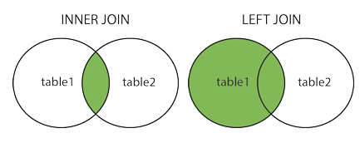
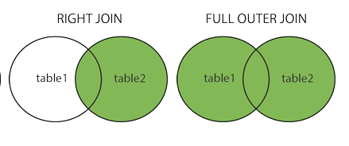
Joint Table

